Slide 1

Auxiliary Data Input Service
CS590
Software Architecture
Supervision by
Professor Siamak Tavakoli Maharishi International University
Team
Md Rashedul Bari Md Rana Hossain Somal Chakraborty Md Shah Jalal Mazumder Amit Yadav Yasmin Beyene Belay

Slide 2
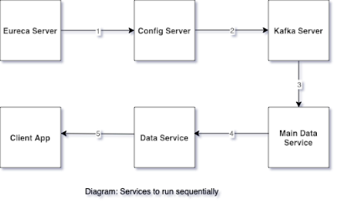
Service Sequence
Prerequisites
Netdata Service
Zookeeper Service Kafka Service

Slide 3
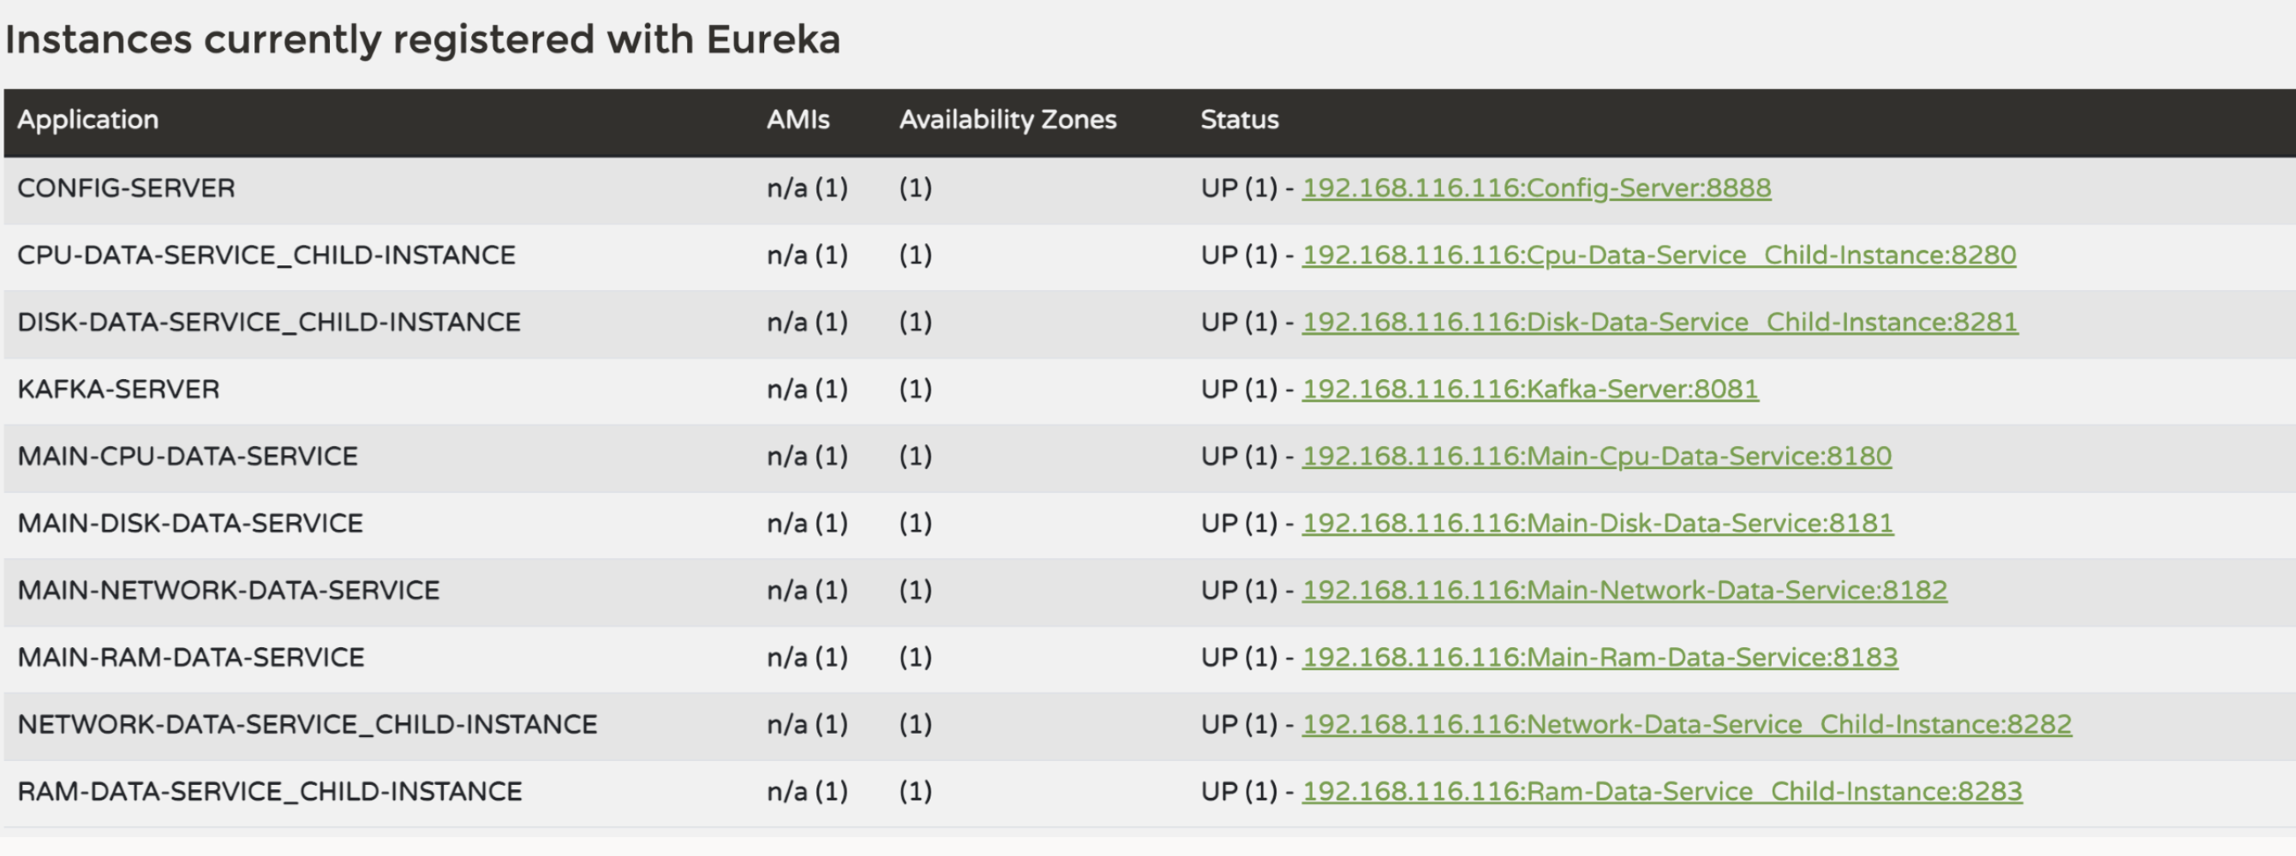
Eureka Service Registry

Slide 4
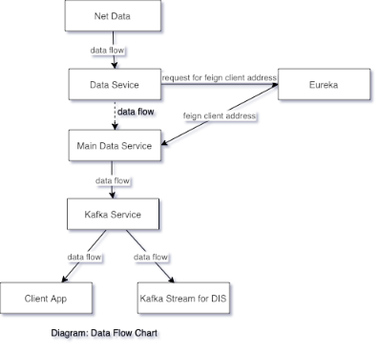
Data Flow Diagram

Slide 5
Retrieving And Sending Machine Metrics To Kafka Stream

Slide 6
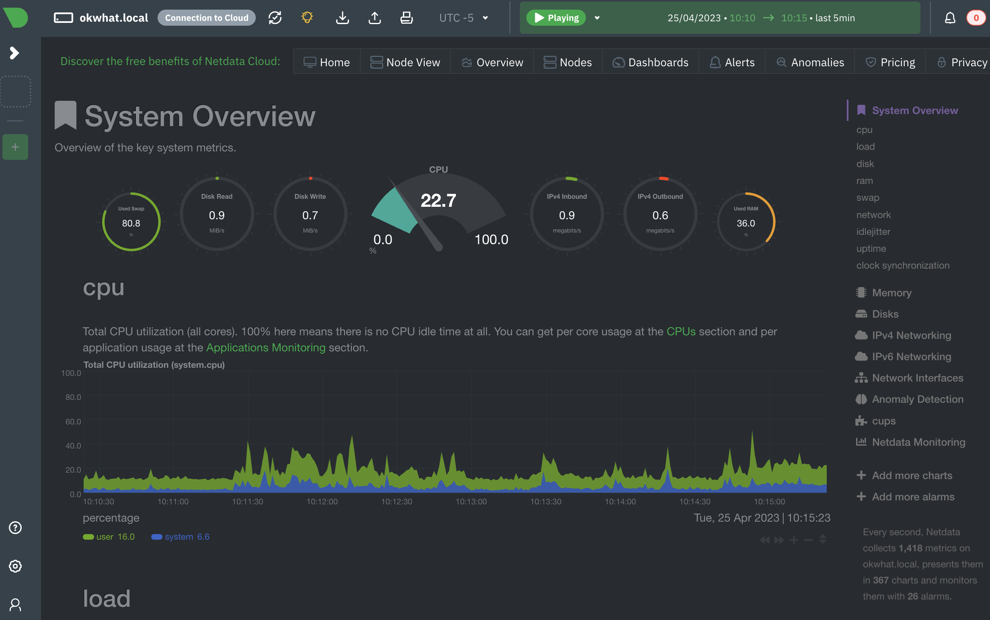
Netdata
We are using Netdata which is a lightweight, real-time monitoring tool which is collecting system metrics, including RAM, CPU, disk usage and network data. Url: http://localhost:19999

Slide 7
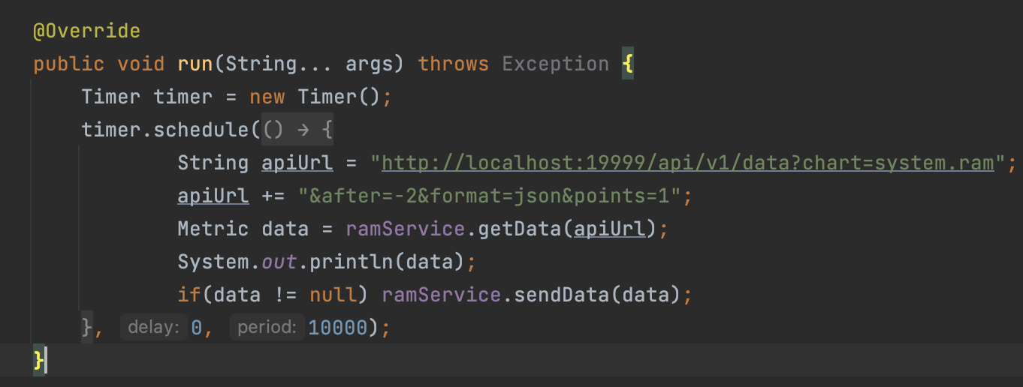
MetricService Fetching Data
MetricService e.g. RamService fetches data from netdata and proceeds to send it Url: http://localhost:19999/api/v1/data?chart=system.ram&after=-2&format=json&points=1

Slide 8
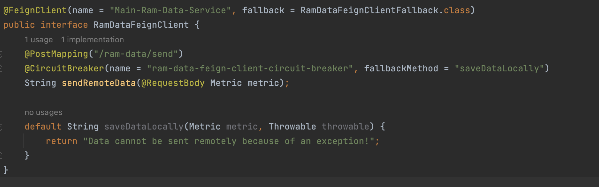
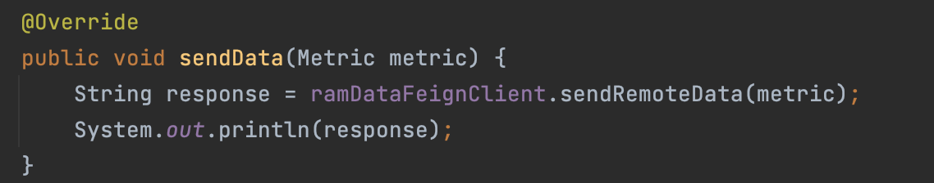
MetricService Sending Data To MainMetricsService
MainMetricsService e.g. MainRamService is registered on eureka and is a feign client for RamService. MainRamService has a POST api that receives the metrics from RamService

Slide 9
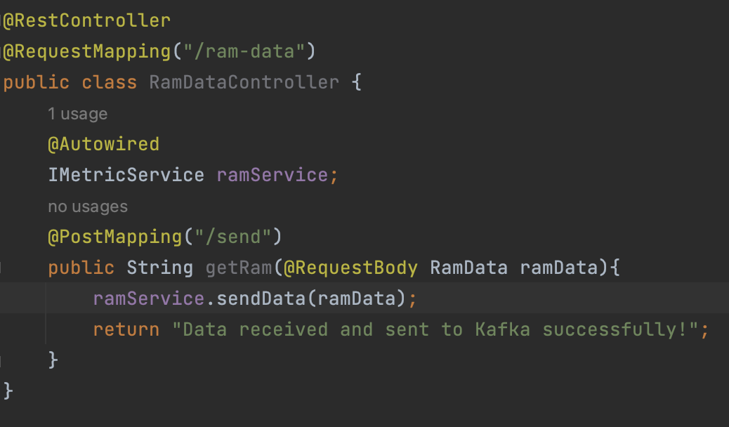
MainMetricsService Receives Data From MetricService
MainMetricsService receives the metrics on the exposed API /ram-data/send via Rest Call

Slide 10
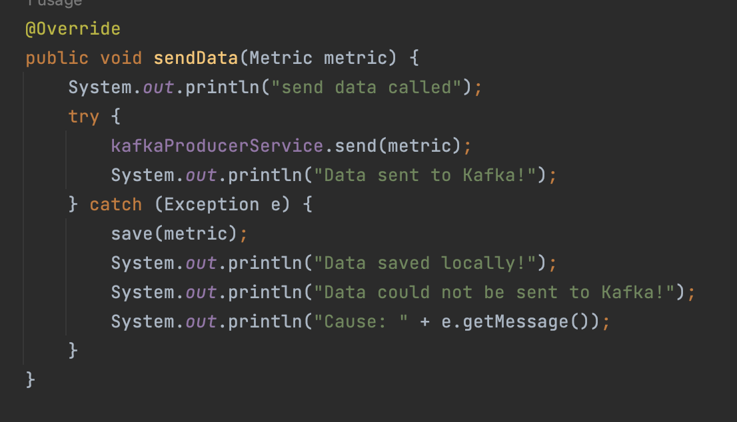
MainMetricsService Sends Data To Kafka Stream
MainMetricsService upon receiving the metrics sends it to the kafka stream on the relevant topic (Topic_Ram-1 here)

Slide 11
Kafka Consumer To Integrate All Metrics

Slide 12
AUXILIARY DATA INPUT SERVICES
MongoDB
EUREKA
KAFKA
Fallback
CPU-SERVICE
API
MAIN-CPU-SERVICE
PUBLISH
TOPIC-CPU
API
PUBLISH
CONSUMER
RAM-SERVICE
MAIN-RAM-SERVICE
TOPIC-RAM
DS
DISK-SERVICE
API
MAIN-DISK-SERVICE
PUBLISH
TOPIC-DISK
REACT
APP
NETWORK-SERVICE
API
MAIN-NETWORK-SERVICE
PUBLISH
TOPIC-NETWORK
CONFIG

Slide 13
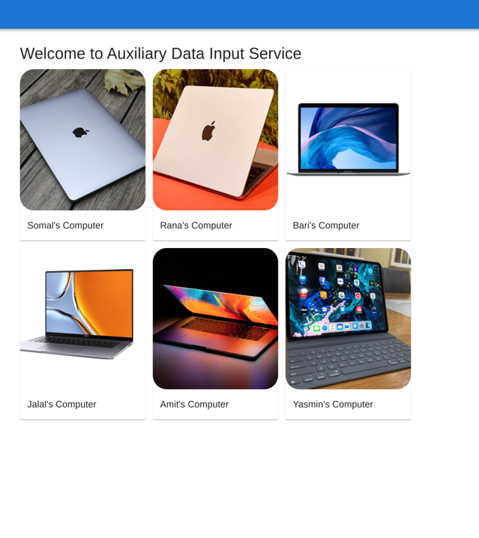
ADIS Client Application
Real time data visualization
Tools: React
Protocol: RestAPI

Slide 14
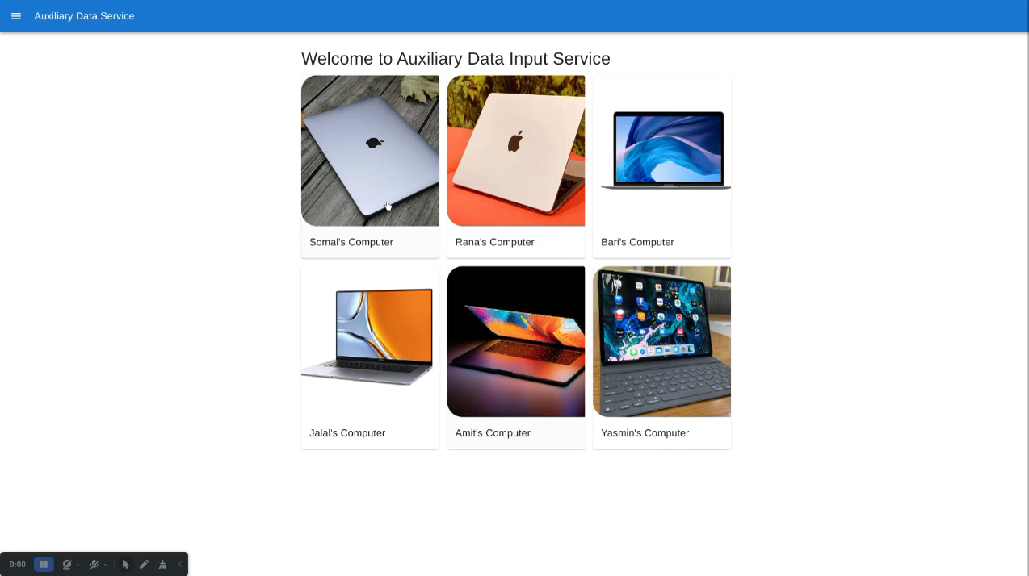
Demo of Client Application
Shows different computer: 1. Ram Data 2. CPU Data 3. Disk Data 4. Network Data

Slide 15
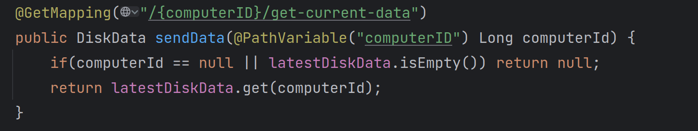
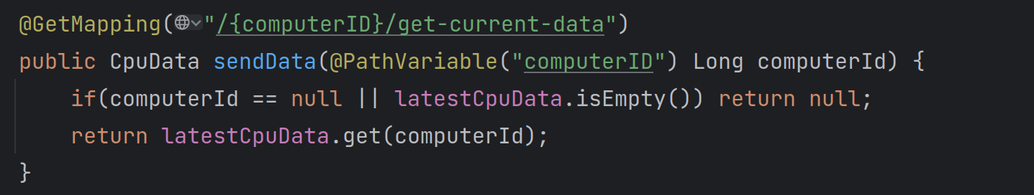
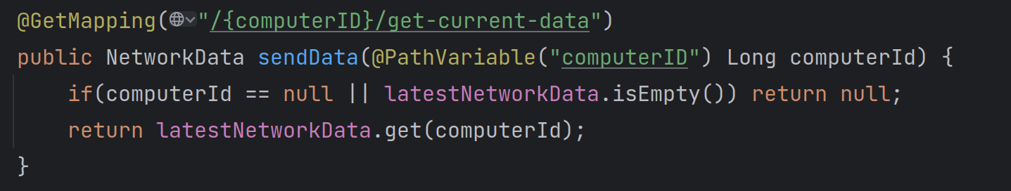
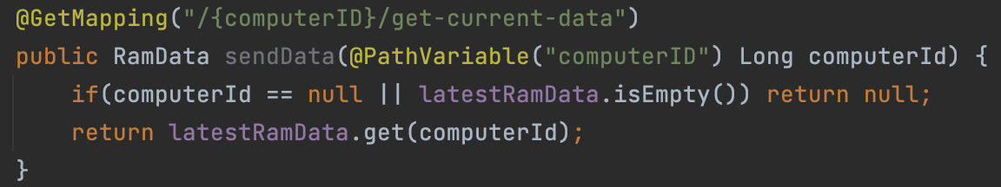
ADIS RestAPI for Client
4 API to get bellow data:
Ram
CPU
Disk
Network

Slide 16
Improvement of the legacy code

Slide 17
Thank you

Slide 18
Any Question?

